Slide 1



VIP, Results/Data webpages to respond to voter/public questions

Slide 2
Agenda
Voter Information Pages
Communicating with voters and navigating VIP
Election Night Result Site
Communicating about Election Results

Slide 3
Voter Information Pages
Know the tools used by voters:
Polling Place Finder
BallotTracker
What does this tool show and what are its limitations?
A voter's ballot status will only show for six months after the election unless another election comes along, in which case the page will only show the status for the most recent election.
Ex: Statewide Primary and Statewide General. The ballot status from the Primary will only remain on the page until the Statewide General is activated.
Check My Registration
Notes:
Grab screenshots of VIP pages? Point out a couple things, familiarize tools on our website

Slide 4
Voter Information Pages
Knowing these pages can help answer questions and concerns!
Ex: “I can’t find my polling place/I don’t see my address listed in Poll Finder”
Ex: “I sent in my AB application but can’t find it on the tool”
Ex: “I’m registered but it says it can’t find my information”
Notes:
Grab screenshots of VIP pages? Point out a couple things, familiarize tools on our website

Slide 5
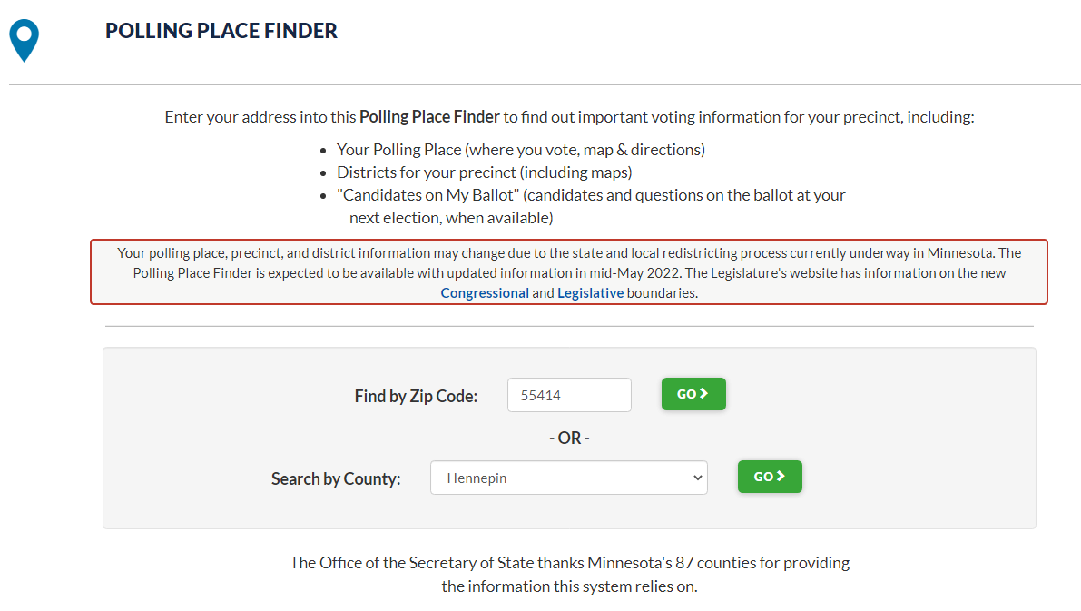
Polling Place Finder
Important to know what can be searched/found here!
Two ways to search
Notes:
Poll Place Finder!
Highlight the things that this tool can deliver to voters
Highlight the two ways to search
I’ve entered my zip code and County for example purposes, lets look at zip code search first

Slide 6
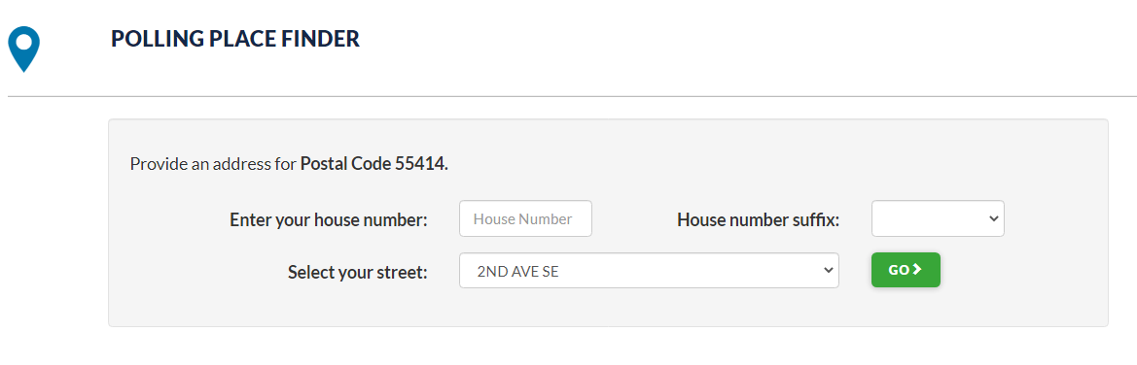
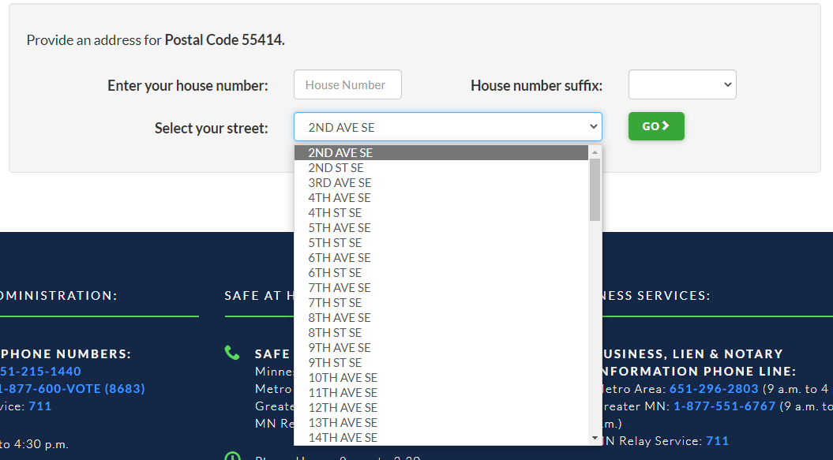
Polling Place Finder
Notes:
We are looking at Postal Code 55414. This means that all address ranges in SVRS that are associated with the above Postal Code will show up in this dropdown EXACTLY as written in SVRS. Once a user selects the house number, suffix if needed, and the street name, they can then hit go and if it corresponds with an address range, it’ll return the polling place associated to that address.
numbered streets spelled out vs using numbers (1st vs first)
different ways highways are entered
Most counties are pretty internally consistent, but if the street list goes cross-county, it can be esp notable

Slide 7
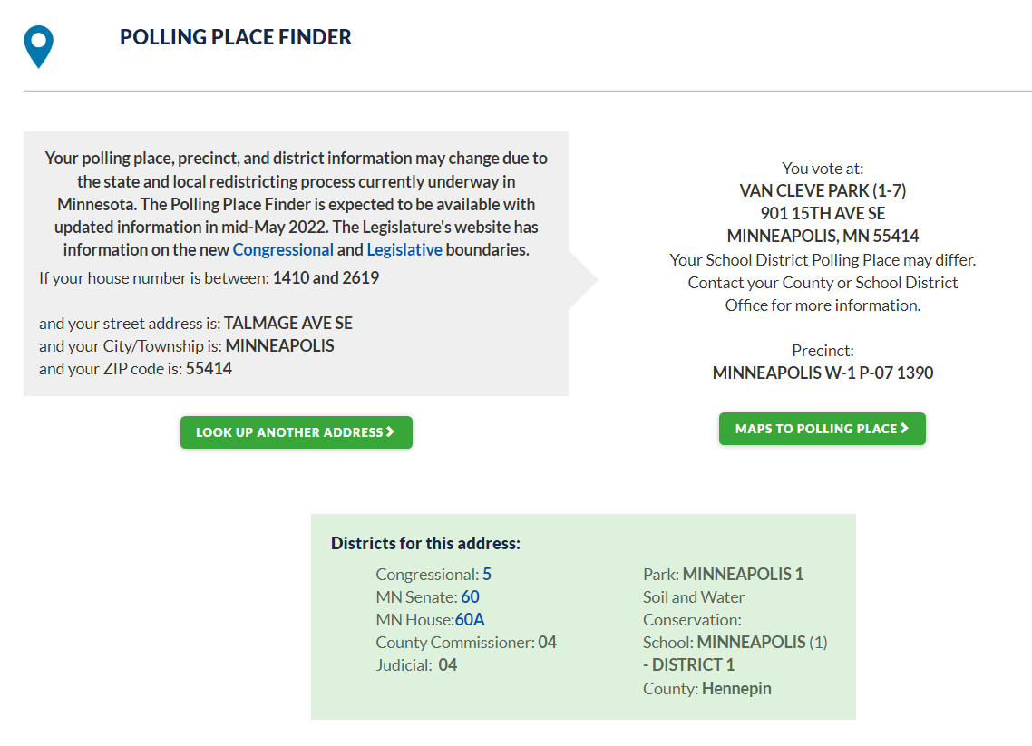
Polling Place Finder
Notes:
Let's look at an example of the return! First, the recap of what was searched. It is literally returned as an address range associated to one in SVRS. I included a screencap of the SVRS address range for reference. You can see a perfect, 1-for-1 match.
You can also see the results boxes on this screen that corresponds with the overview we had on the home page. Polling place, precinct, districts, and if I had an active election upcoming, you could see that listed and there would be a link to the sample ballot.
Congressional and Legislative districts have PDF maps associated to them.

Slide 8
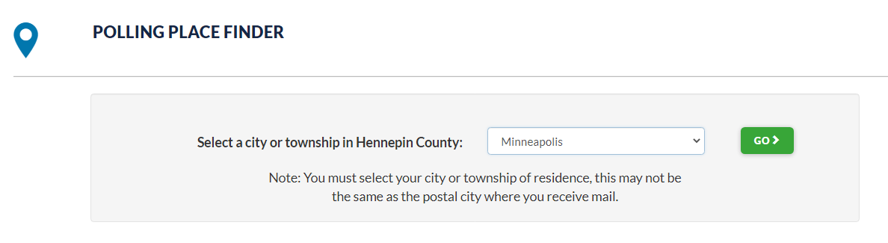
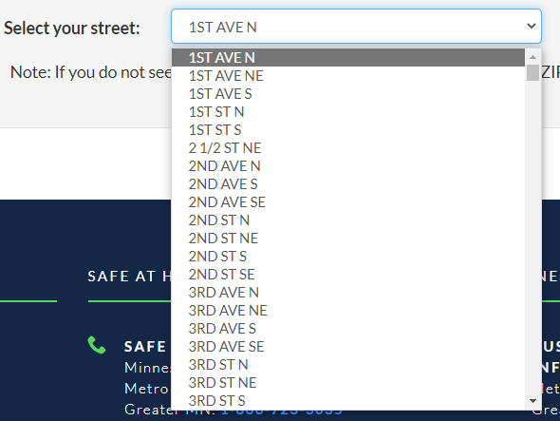
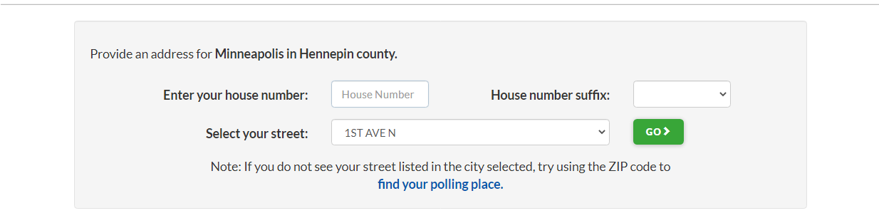
Polling Place Finder
Notes:
Let’s now look at searching by selecting County first from the home page. It gives you an ask for a city and then once you pick the city, it’ll give you the same ask for house number, suffix, and street name. That said, as it seen in the second screenshot, the list will be every street name from the city of Minneapolis. Obviously, this is a huge list, but folks may have a hard time finding what they are looking for incase they have a different idea of the name or if the list is ordered different than anticipated.

Slide 9
Polling Place Finder
Notes:
Let's look at an example of the return! First, the recap of what was searched. It is literally returned as an address range associated to one in SVRS. I included a screencap of the SVRS address range for reference. You can see a perfect, 1-for-1 match.
You can also see the results boxes on this screen that corresponds with the overview we had on the home page. Polling place, precinct, districts, and if I had an active election upcoming, you could see that listed and there would be a link to the sample ballot.
Congressional and Legislative districts have PDF maps associated to them.

Slide 10
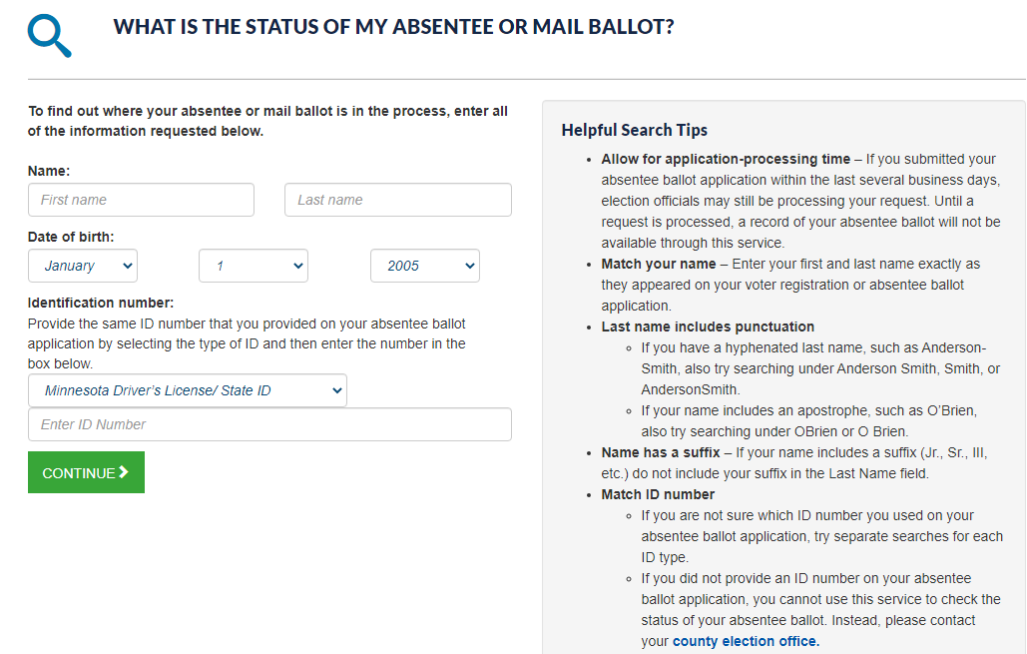
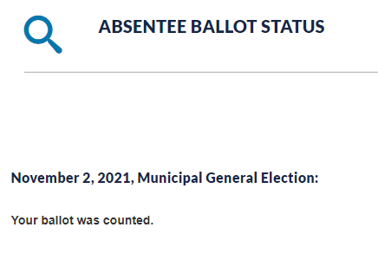
Ballot Status Lookup
Notes:
Becky and I will go over the Ballot Status Tool in more detail but I wanted to at least mention it in this presentation since it is important when communicating with voters during an election season. Ballot Tracker, or Ballot Status Lookup Tool, is helpful in seeing what status a given ballot pack is in. This info, like the other tools, pulls directly from SVRS.
Tips for trouble shooting this site:
1) Did the voter use the other ID number?
2) Is there an error in the AB App on SVRS?
3) Is the name entered into SVRS different than the voter anticipated?

Slide 11
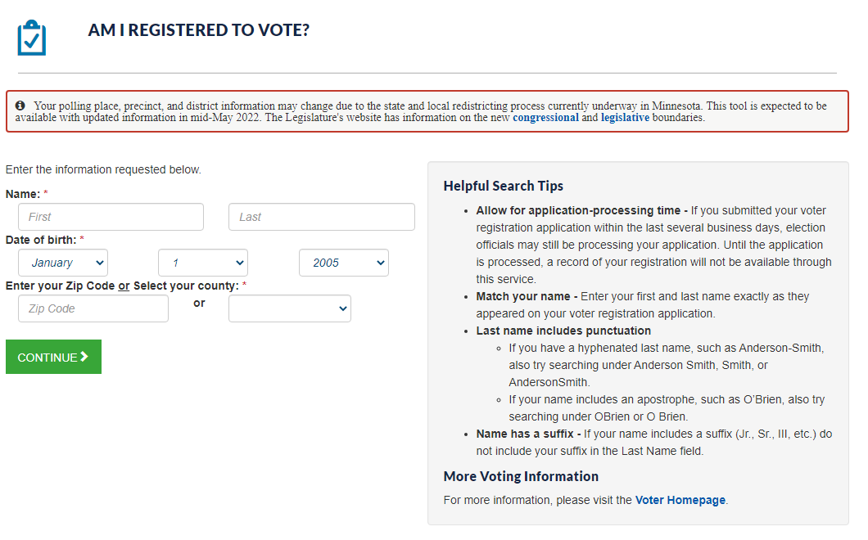
Check My Registration
Notes:
We have been getting an increased volume of calls and emails from voters who are having trouble with this tool, perhaps you have experienced the same yourselves.
This tool, just like Poll Place Finder, Ballot Status Lookup, and Check my Registration, these tools search data provided by you all. It is looking for one-to-one matches in SVRS. That is why we offer examples on the right of someone with a hyphenated last name. I’m sure you all know this, but the simplest way I describe it over the phone is if someone is registered as Patrick and enters Pat into this tool, it will not return their record. A voter will enter the data, name, DOB, and address, and if it exists the exact same in SVRS, it’ll give the status (registered, challenged, etc.). If it cannot match, it says the message that it cannot be found.

Slide 12
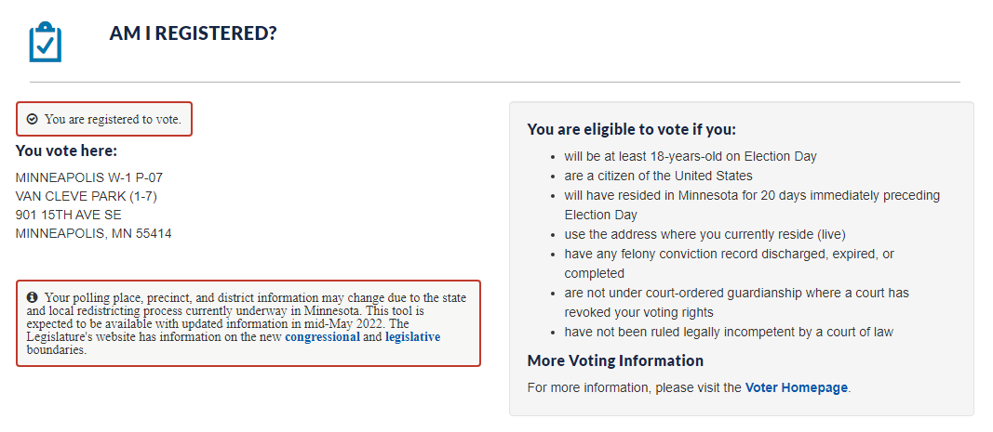
Check My Registration

Slide 13
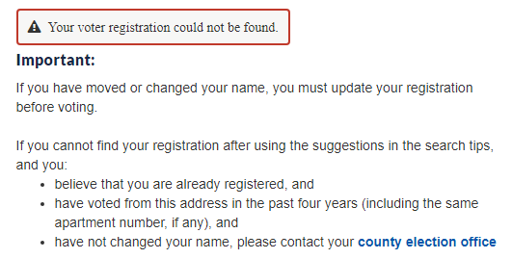
Check My Registration
Notes:
Let’s go through this screen piece by piece. It says, “Your voter registration could not be found”. This means that with the data provided, SVRS didn’t find a match. It does not mean, with certainty, that the person isn't registered. Not Found vs Not registered.
It then provides some information to the voter. For folks who register and then check immeditately, there is a day delay compared to when edits are made in SVRS and what reflects on this screen. Perhaps the person moved and typed in their new address? We say that if someone cannot find their registration, is sure they are registered, haven’t moved and voted there, and haven’t changed their name, they need to contact you all!
A voter who doesn’t have a DOB in their record won’t be able to use this tool. A voter with a typo or error in their registration, likely won’t have success with this tool. Mistakes happen, perhaps something got typed in wrong, a phone call with your office should key you in to go into SVRS and look at the record. It is a one-for-one match.

Slide 14
Communicating with voters and navigating VIP
Using online tools to help the public and helping the public using online tools
Knowledge of what informs these systems helps answer why voters see what they see
To come back to our examples:
“I can’t find my polling place”
A voter may know their address is 123 E Maple St, but we have 123 Maple St E. Even if they find the right street, they may think it's wrong or missing their street, which leads to questions and concerns.
In the case of a true issue (such as an address not being included in an address range), timeliness and explanations always help voters who don’t know what goes on behind the scenes!

Slide 15
Communicating with voters and navigating VIP
“I sent in my AB but can’t find it”
Confusion over which ID number was used could mean they don’t see the record. Try the other number
Once they find the AB record, explaining what each steps means and what informs BallotTracker
“I’m registered but it says it can’t find my information”
Have you recently moved? Does the name typed in match what your voter record would say?

Slide 16
Election Results!

Slide 17
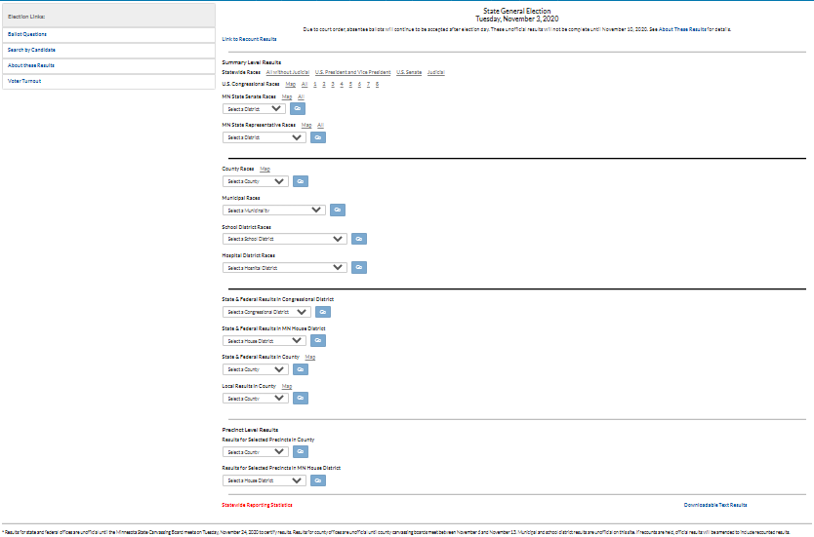
A Tour Through Election Results

Slide 18
ENR Home page sections
Summary results – federal/state
Summary results – local
Results within district/county
Results by precinct

Slide 19
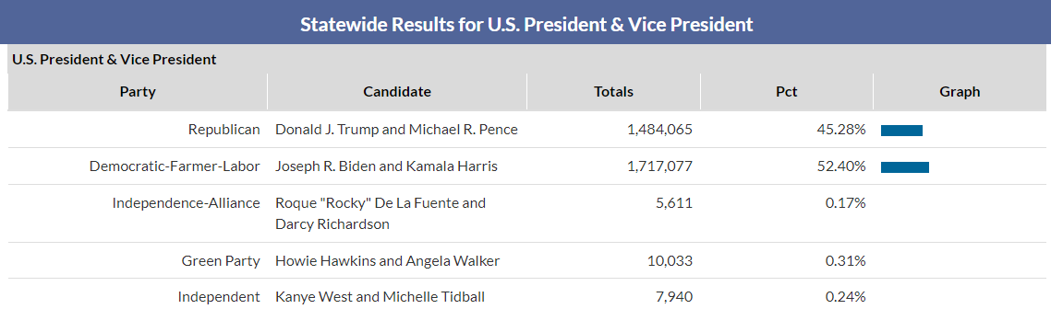
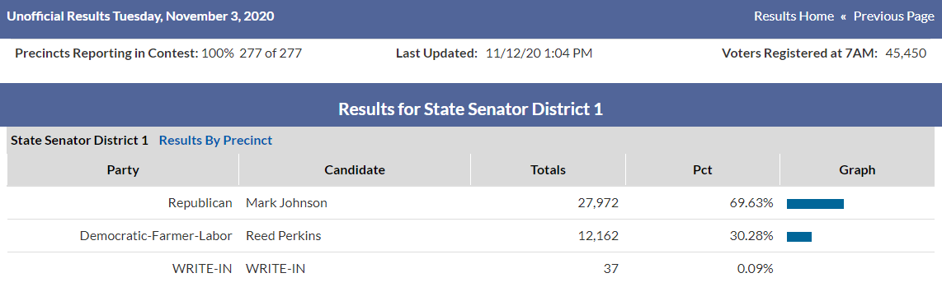
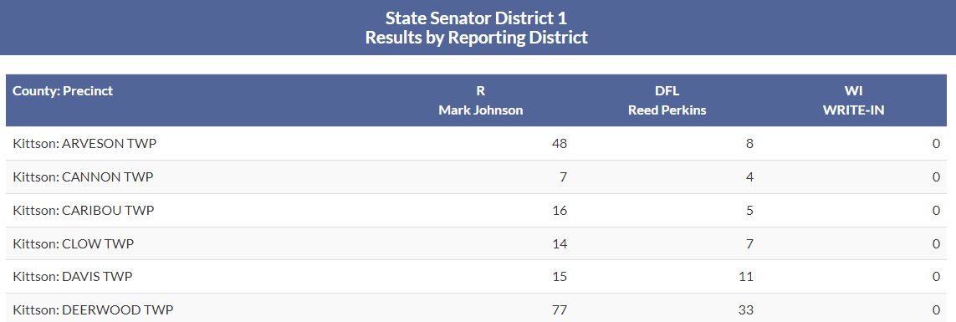
Drilling down into results
Federal and statewide:
only summary available
All other races:
Can view results by precinct

Slide 20
Results header
Unofficial Results
Precincts Reporting
Last Updated
Voters Registered at 7AM

Slide 21
ENR Home page bottom links
Statewide Reporting Statistics

Slide 22
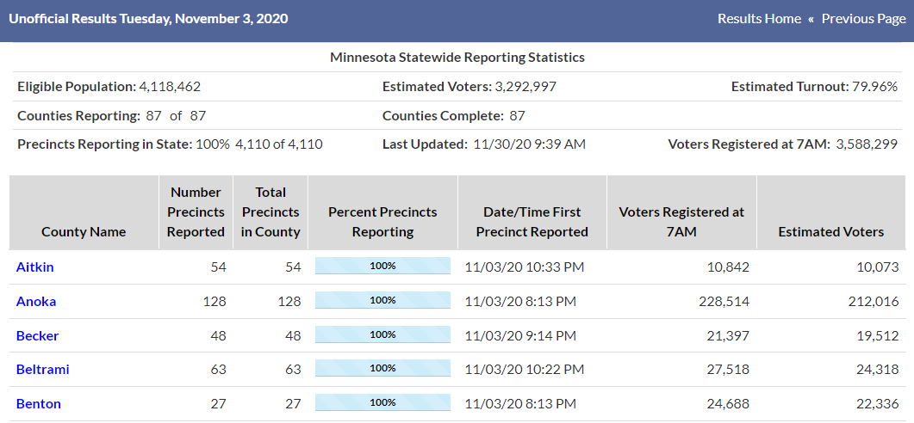
Statistics Page Header
Eligible Population:
Statewide estimate from Dr. Michael McDonald – November even year only.
(Need local estimate? Try Census' Citizen Voting Age Population)
Estimated Voters:
Uses total voting statistics. Before statistics entered, will use statewide race such as US President or Governor.
Estimated Turnout:
Estimated Voters divided by Eligible Population. November even year only.

Slide 23
County Statistics Page
Reporting Statistics
First reported – time of first results entered in county/precinct
Precincts Reported – how many have had results entered (appearing on website?)
Percent Precincts Reporting – how many have had results entered
NOTE:
First results entered may not be final results!
For most elections, want 100% before going home. Also take a glance at numbers

Slide 24
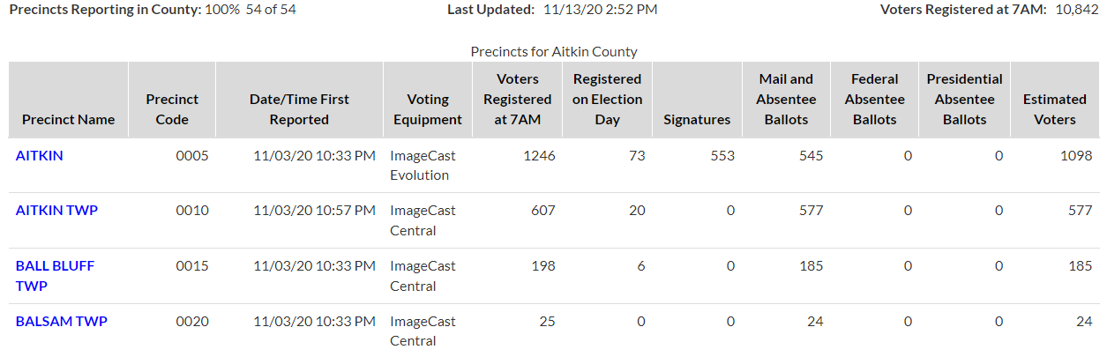
Precinct Statistics Page
7AM:
Pulled from SVRS into ERS. Only rarely need to change
Voting Equipment:
Update in ERS
EDR:
Totals polling place and absentee
Signatures:
Polling place only

Slide 25
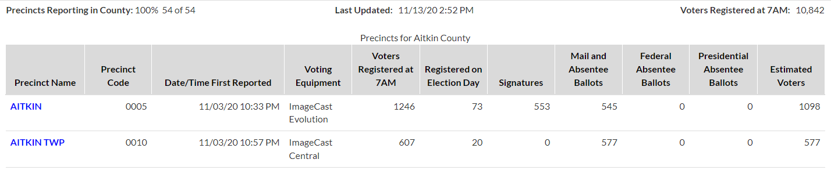
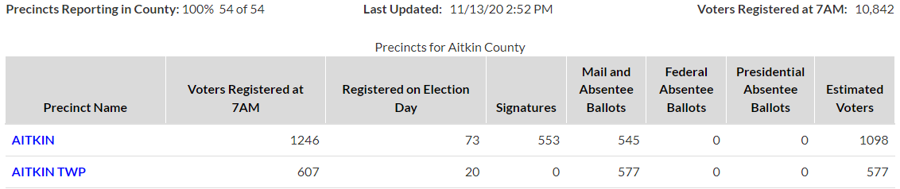
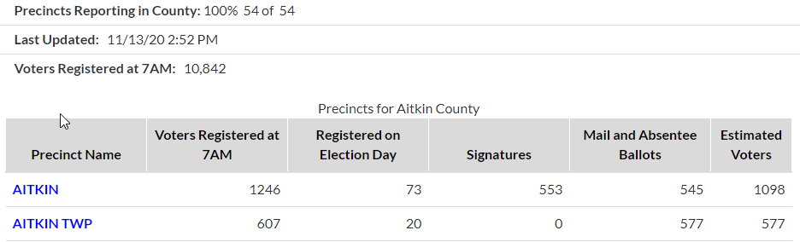
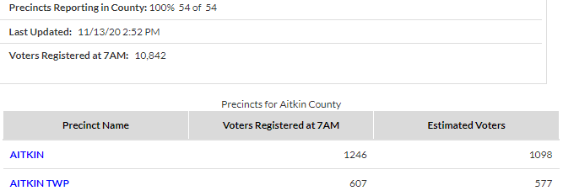
Responsive Design

Slide 26
ENR Home page bottom links
Downloadable Text Results

Slide 27
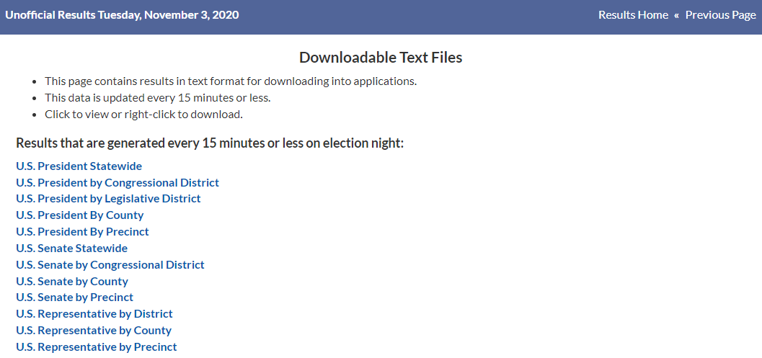
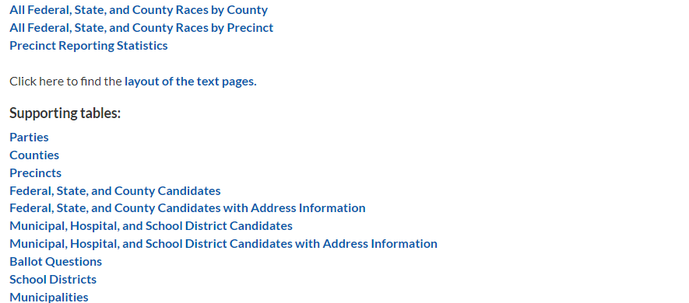
Text file highlights
All federal/state/county races. Big files but useful to those who work with data
Precinct statistics
Format info
Candidate names and contact info

Slide 28
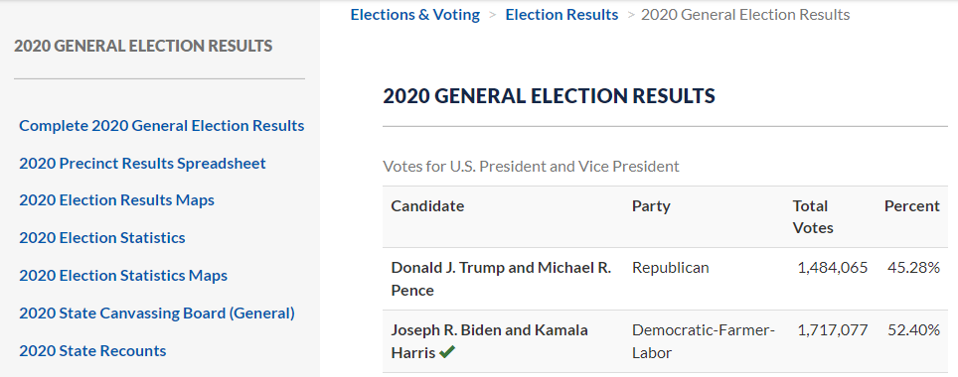
Results on OSS website

Slide 29
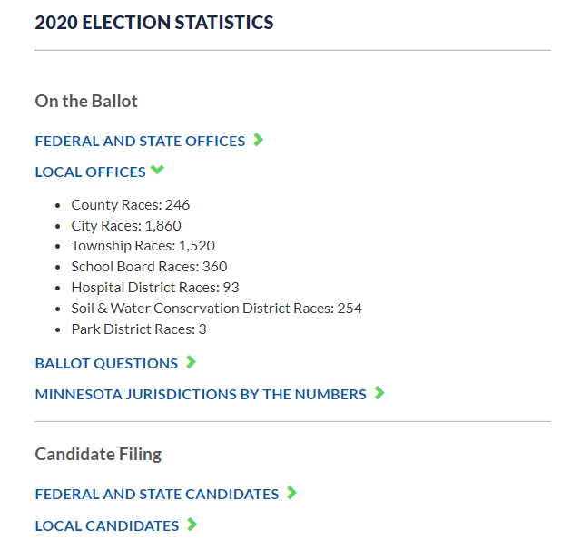
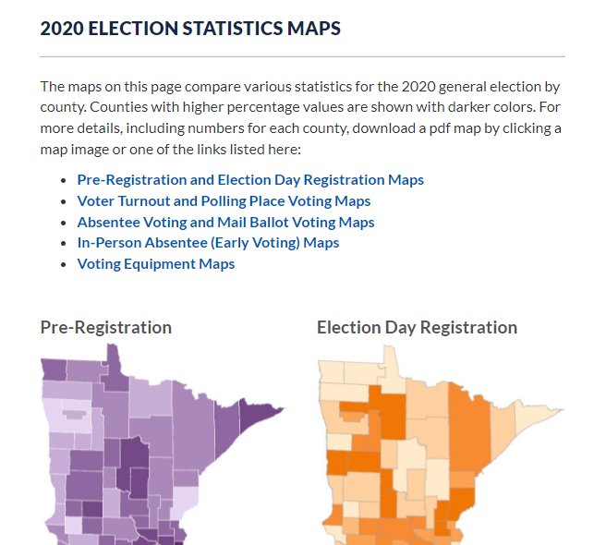
Election Statistics Numbers & Maps

